Slide 1
Melanoma Tumor Size Pred
Presentation

Slide 2
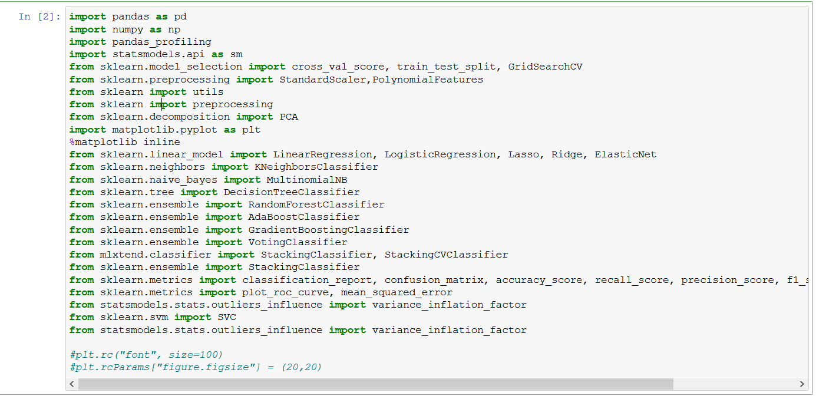
Libraries used

Slide 3
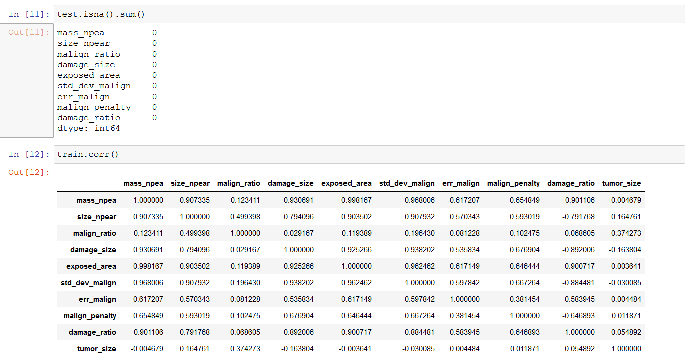
Pre-processing done - 1

Slide 4
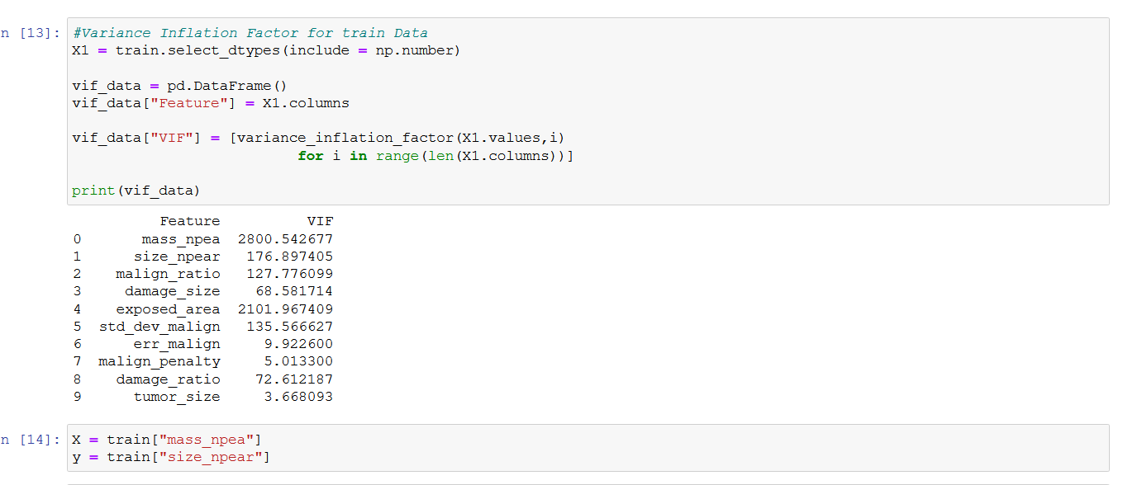
Pre-Processing Done - 2

Slide 5
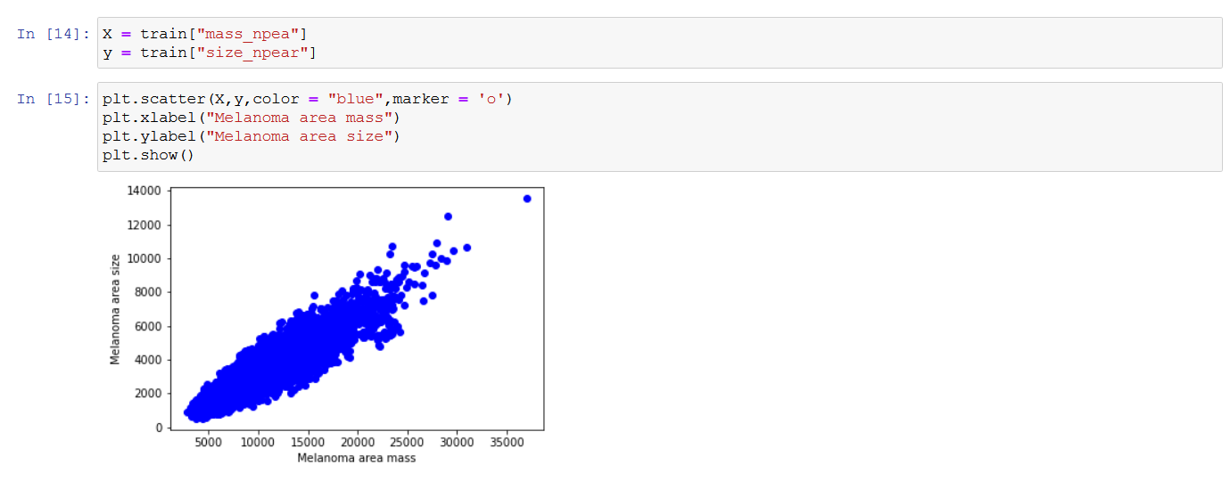
Pre-Processing Done - 3

Slide 6
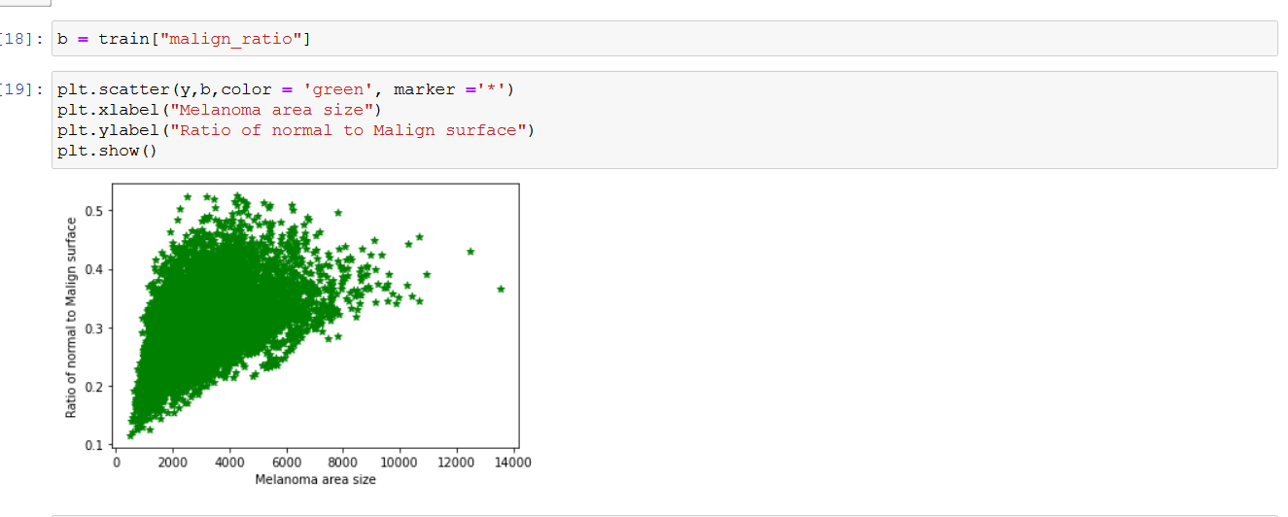
Melanoma Area Size Vs Ratio of Normal to Malign

Slide 7
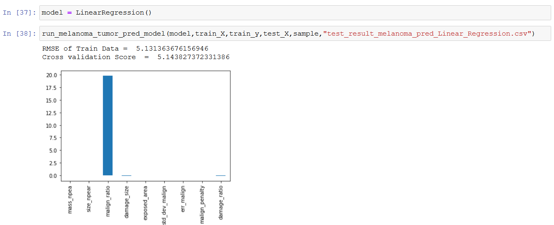
Linear Regression

Slide 8
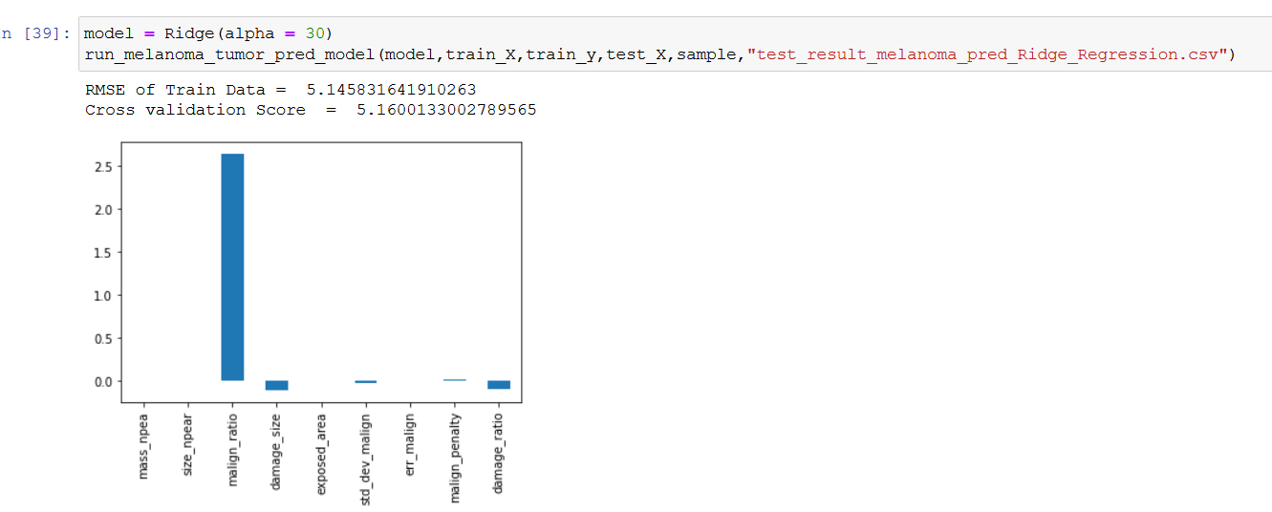
Ridge Regression

Slide 9
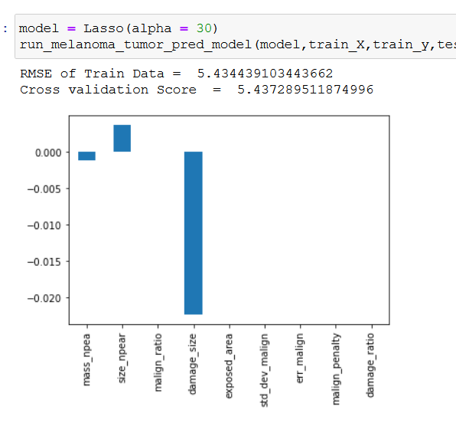
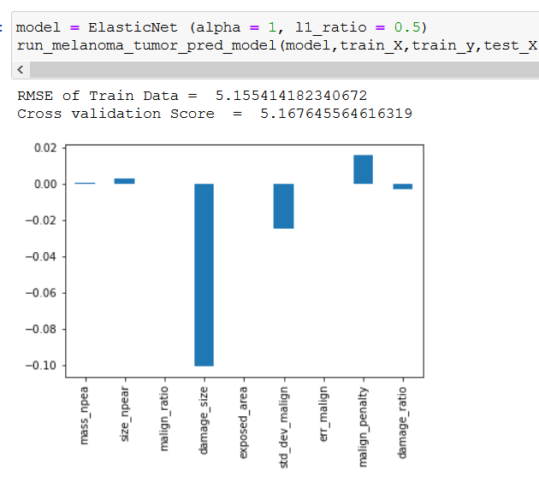
Lasso and Elastic Net

Slide 10
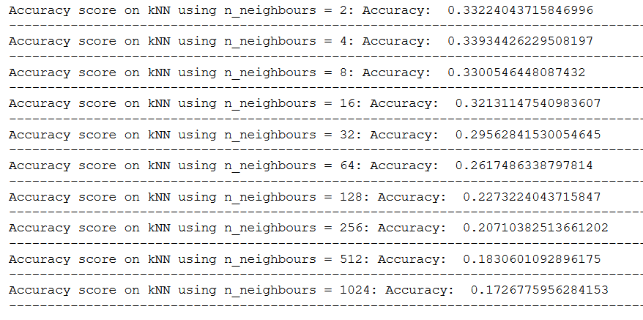
KNN Algorithm
KNN Algorithm for K = 1
KNN Algorithm for K = 2,4,8,16,32,64,128,256,512,1024

Slide 11
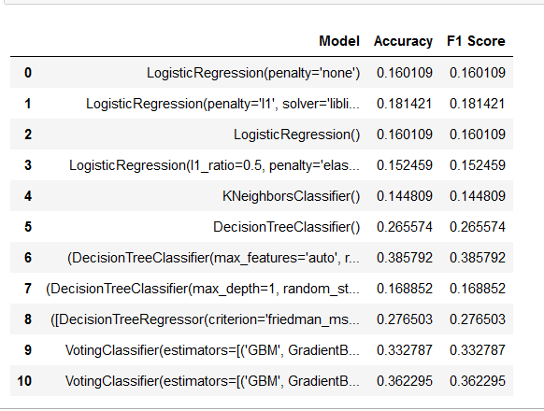
Gradient Boost and Random Forest with Classifiers

Slide 12
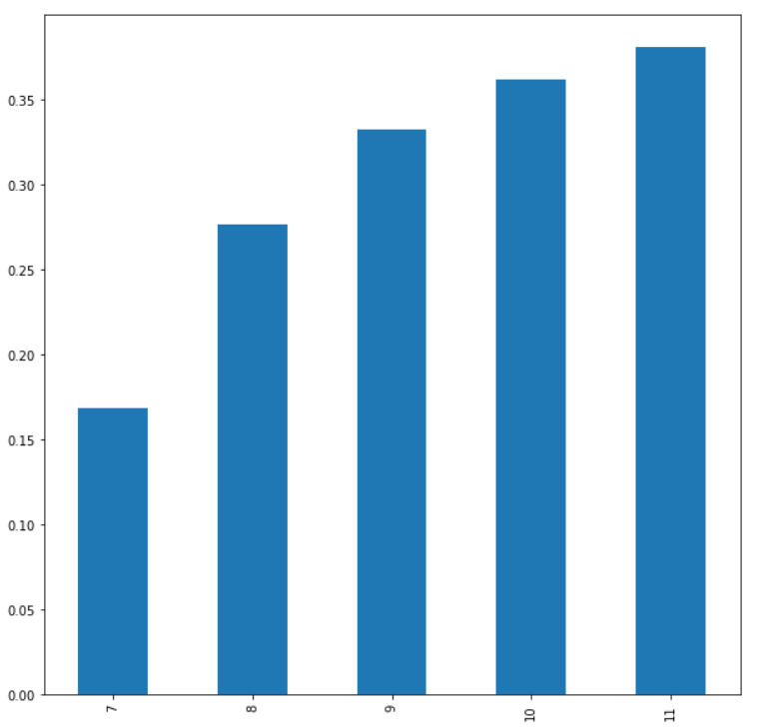
Final Graph Showing the increase in accuracy

Slide 13
Finally - Scores on Machine Hack

